Slide 1
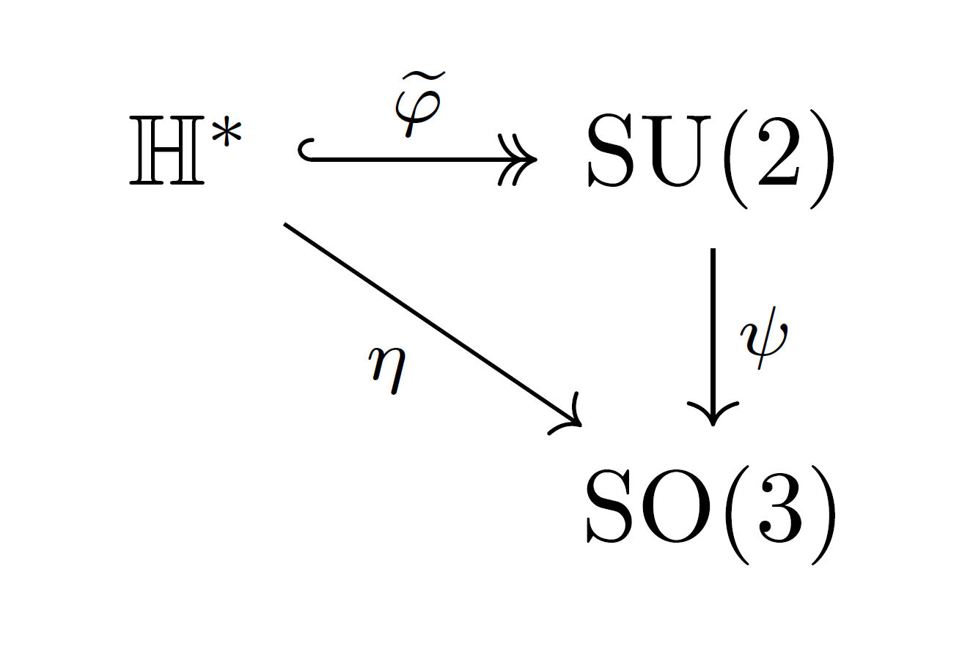
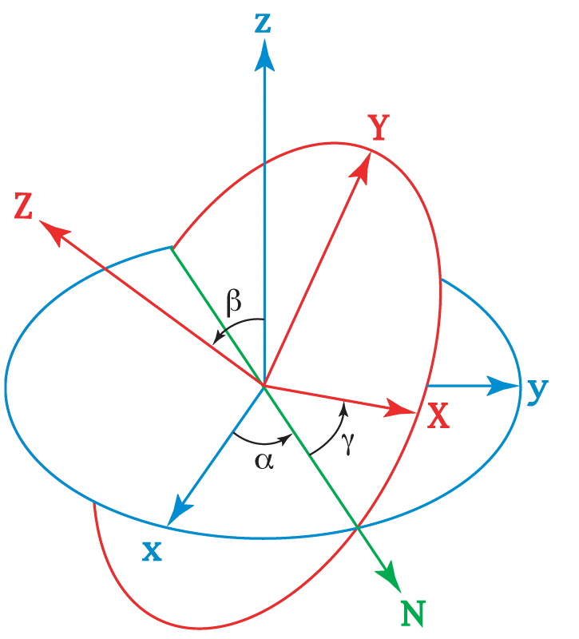

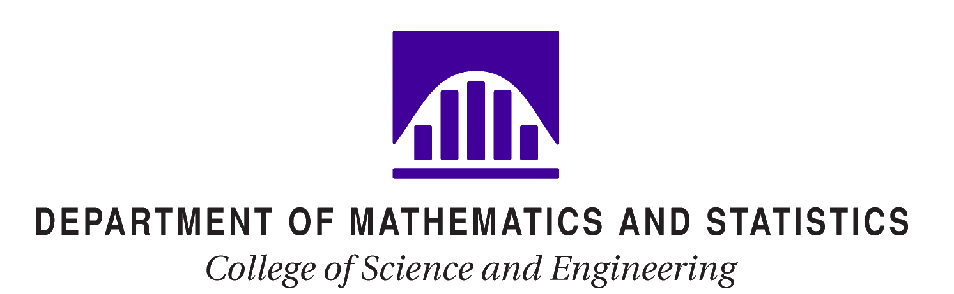

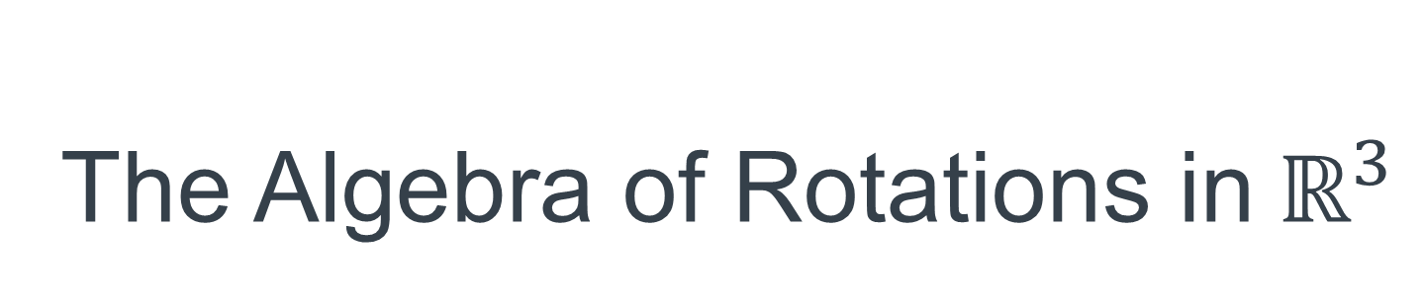
The Algebra of Rotations in$ℝ^{3}$
An Exploration of Representations by Quaternions,$SU(2),$and $SO(3)$
Nicholas Meyer nmeyer14@winona.edu Winona State University
Notes:
Look @ audience
Make eye contact
Make 3x5 notecards
No hands in pockets
Always look happy
Mention Aaron Wangberg, Joyati Debnath, Tevian Dray, Sarah Phan-Budd

Slide 2
Acknowledgements
“This project has been sponsored by a student project grant from Winona State University.”
Advisors: Dr. Aaron Wangberg, Dr. Joyati Debnath
Special Thanks: Dr. Tevian Dray, Dr. Sarah Phan-Budd

Slide 3
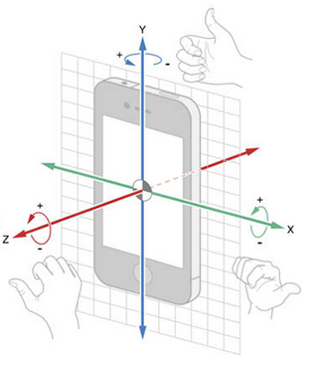
Outline
Euler Angles
Rodrigues Rotation Formula
Hamilton’s Quaternions
The Versor Convention
Matrices, Maps, and Morphisms!
Comparison of Representations
Practical Application (Computer Animation!)

Slide 4
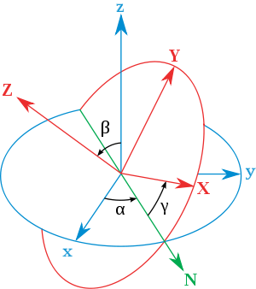
Euler Angles
1765- Euler studied the mechanics of rotating bodies
Decomposition of Motion
Need 6 parameters to rotate a on object
Many constraints on what the parameters can be
Hard to do computations with
Notes:
Use hands to demo translational and rotational motional

Slide 5
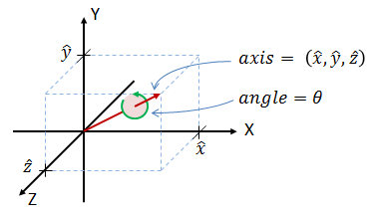

The Rodrigues Rotation Formula (RRF)
1840- Published paper using Euler’s Four Square Identity
If $\vec{v},\vec{e}∈ℝ^{3}$and |$\vec{e}$| = 1, to rotate $\vec{v}$ about $\vec{e}$ by some angle $ρ=2θ: {\vec{v}}_{rot}=\vec{v}\cos{θ}+\left(\vec{e}×\vec{v}\right)\sin{θ}+\vec{e}\left(\vec{e}∙\vec{v}\right)\sin{θ}$
Notes:
Olinde Rodrigues – French mathematician
so(3) -> SO(3) without using the matrix exponential

Slide 6
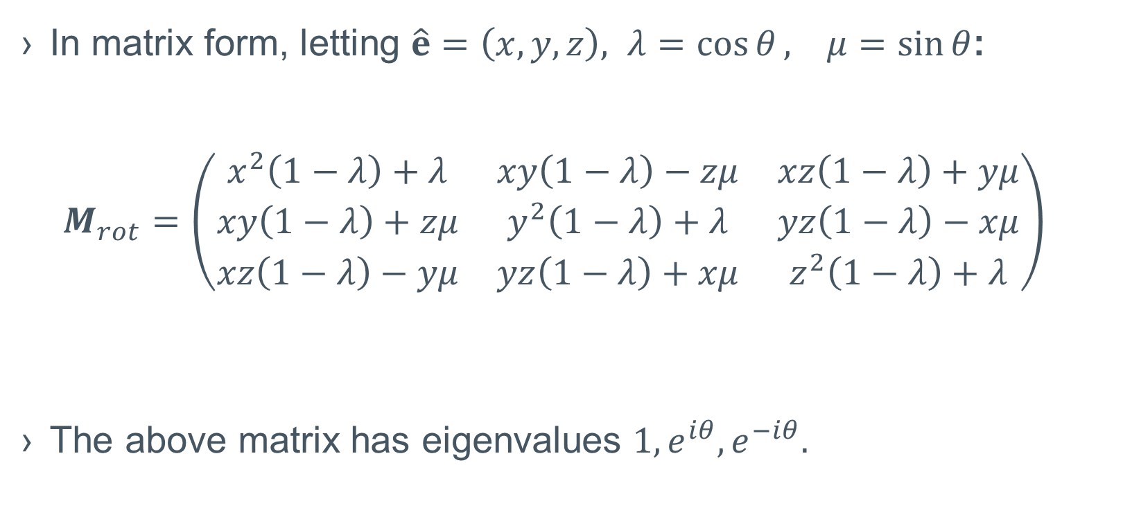
The Rodrigues Rotation Formula (Cont’d)
In matrix form, letting $\hat{e}=\left(x,y,z\right), λ=\cos{θ}, μ=sin⁡θ$:
$$M_{rot}=\left(\begin{matrix}x^{2}\left(1−λ\right)+λ & xy\left(1−λ\right)−zμ & xz\left(1−λ\right)+yμ \\ xy\left(1−λ\right)+zμ & y^{2}\left(1−λ\right)+λ & yz\left(1−λ\right)−xμ \\ xz\left(1−λ\right)−yμ & yz\left(1−λ\right)+xμ & z^{2}\left(1−λ\right)+λ\end{matrix}\right)$$
The above matrix has eigenvalues $1, e^{iθ},e^{−iθ}.$
Notes:
From product of Eigenvalues = Determinant ID, we have Det 1
ICBS that M_rot is orthogonal, hence M_rot is in SO(3)
Since dim(SO(3)) = 3(3-1)/2 = 3, and M_rot is determined by 3 paramaters, (2 of x, y, z and θ), the M_rots represent SO(3) up to transpose.

Slide 7
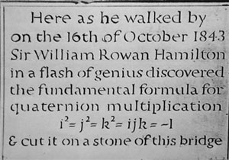
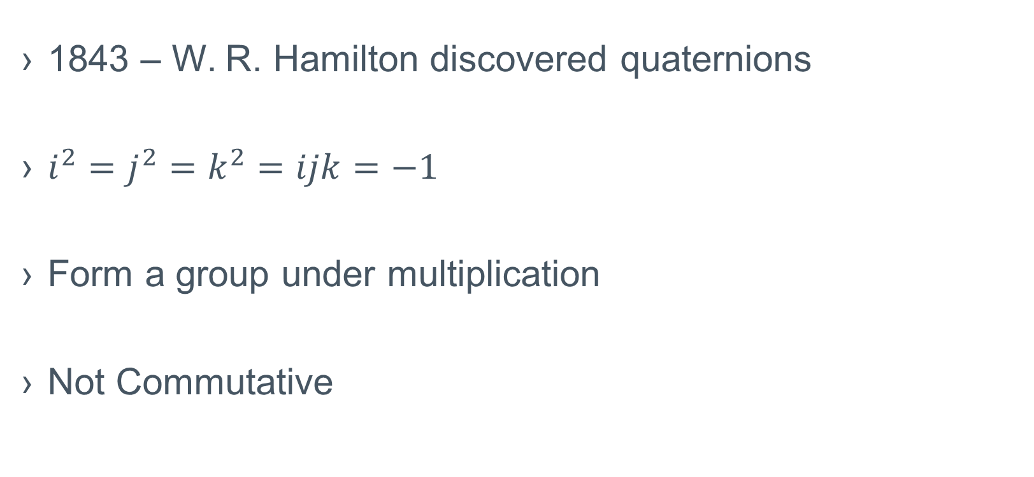
Hamilton’s Quaternions
1843 – W. R. Hamilton discovered quaternions
$i^{2}=j^{2}=k^{2}=ijk=−1$
Form a group under multiplication
Not Commutative
Notes:
Every morning in the Month of October 1843, Willan Edward Hamilton, son of WR Hamilton asked his father “Papa, can you multiply triples?” Always replied, “no, but I can add and subtract them” His mistake was thinking in 3D

Slide 8
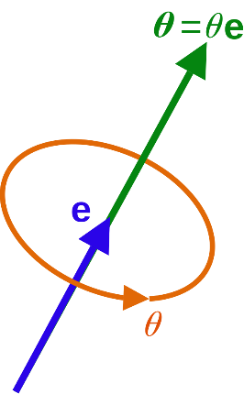
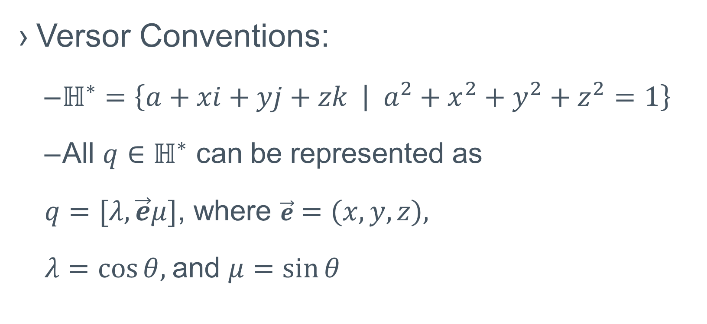
The Quaternions as Rotations (Versors!)
Versor Conventions:
$ℍ^{∗}=\left\{a+xi+yj+zk | a^{2}+x^{2}+y^{2}+z^{2}=1\right\}$
All $q∈ℍ^{∗}$ can be represented as
$q=[λ,\vec{e}μ]$, where $\vec{e}=\left(x,y,z\right),$
$λ=cos⁡θ,$and $μ=sin⁡θ$
Notes:
1874 - Jules Hoüel – “Théorie Élémentaire des Quantités Complexes” vol 4. Developed ideas in Spherical Trigonometry

Slide 9

Matrices, Maps, and Morphisms
Notes:
Say SULU and SOLO for group names

Slide 10
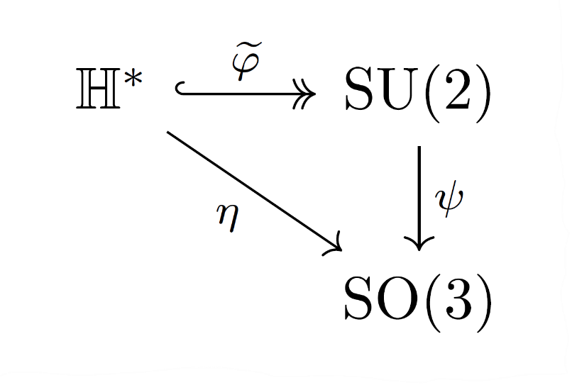

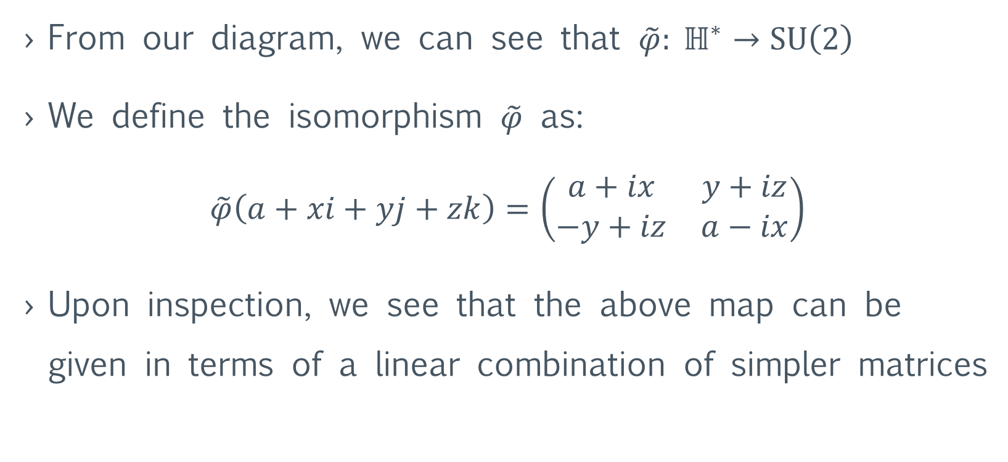
Quaternions and $SU(2)$
From our diagram, we can see that $\tilde{φ}: ℍ^{∗}→SU\left(2\right)$
We define the isomorphism $\tilde{φ}$ as:
$$\tilde{φ}\left(a+xi+yj+zk\right)=\left(\begin{matrix}a+ix & y+iz \\ −y+iz & a−ix\end{matrix}\right)$$
Upon inspection, we see that the above map can be given in terms of a linear combination of simpler matrices

Slide 11
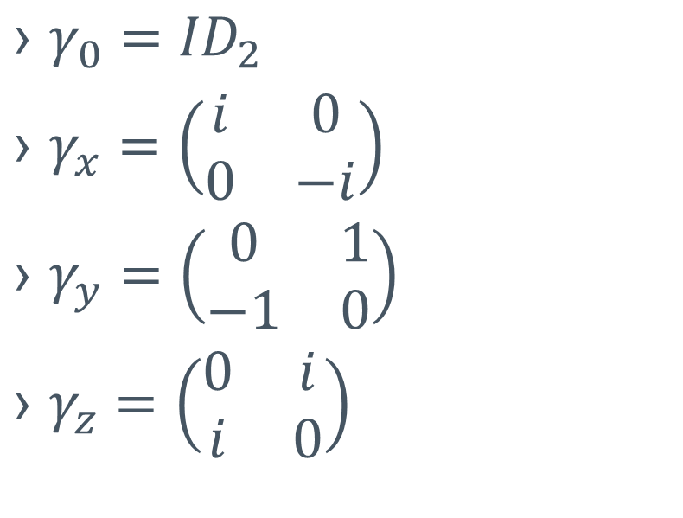
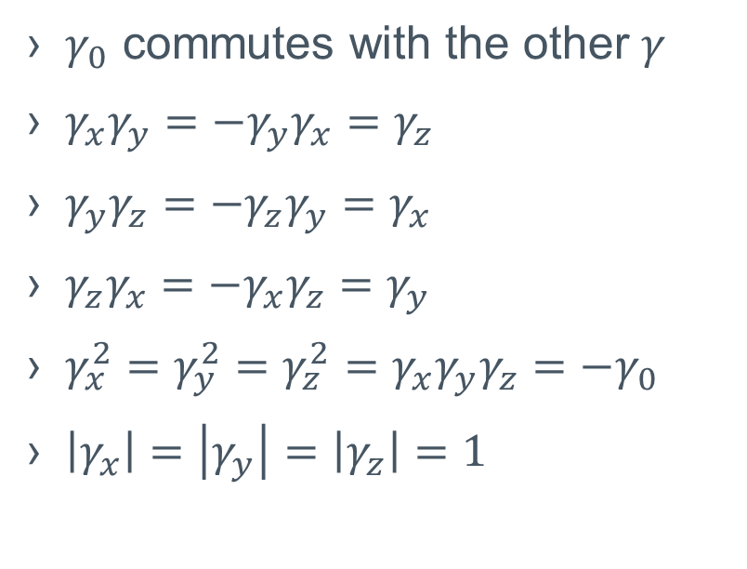
The Quaternion Matrices
The Matrices
Their products
$γ_{0}={ID}_{2}$
$γ_{x}=\left(\begin{matrix}i & 0 \\ 0 & −i\end{matrix}\right)$
$γ_{y}=\left(\begin{matrix}0 & 1 \\ −1 & 0\end{matrix}\right)$
$γ_{z}=\left(\begin{matrix}0 & i \\ i & 0\end{matrix}\right)$
$γ_{0}$ commutes with the other $γ$
$γ_{x}γ_{y}=−γ_{y}γ_{x}=γ_{z}$
$γ_{y}γ_{z}=−γ_{z}γ_{y}=γ_{x}$
$γ_{z}γ_{x}=−γ_{x}γ_{z}=γ_{y}$
$γ_{x}^{2}=γ_{y}^{2}=γ_{z}^{2}=γ_{x}γ_{y}γ_{z}=−γ_{0}$
$\left|γ_{x}\right|=\left|γ_{y}\right|=\left|γ_{z}\right|=1$
Notes:
It is easy to show that the γ_i form a basis set for SU(2) where the scalars come from R, under the condition that the coordinates, taken as a vector in R^4 has norm 1.

Slide 12
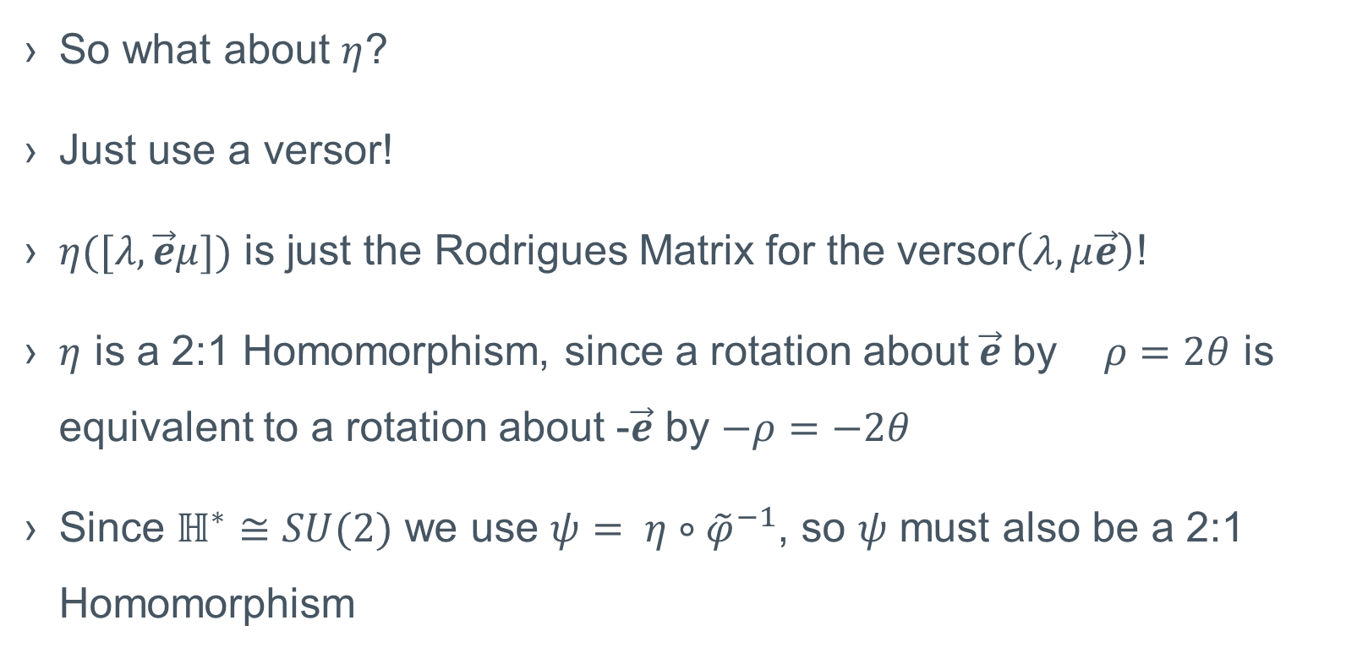
Quaternions and SO(3)
So what about $η$?
Just use a versor!
$η([λ,\vec{e}μ])$ is just the Rodrigues Matrix for the versor$\left(λ,μ\vec{e}\right)$!
$η$ is a 2:1 Homomorphism, since a rotation about$\vec{e}$ by $ρ=2θ$ is equivalent to a rotation about -$\vec{e}$ by $−ρ=−2θ$
Since $ℍ^{∗}≅SU(2)$ we use ${ψ= η∘\tilde{φ}}^{−1}$, so $ψ$ must also be a 2:1 Homomorphism
Notes:
The map ψ is very complicated and quite messy!

Slide 13
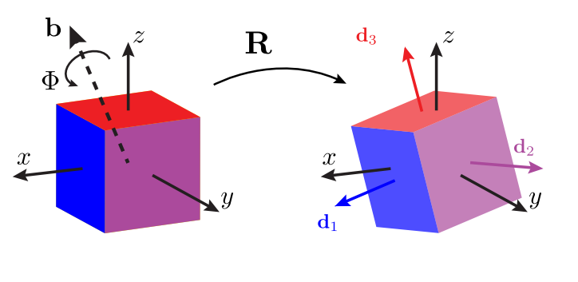
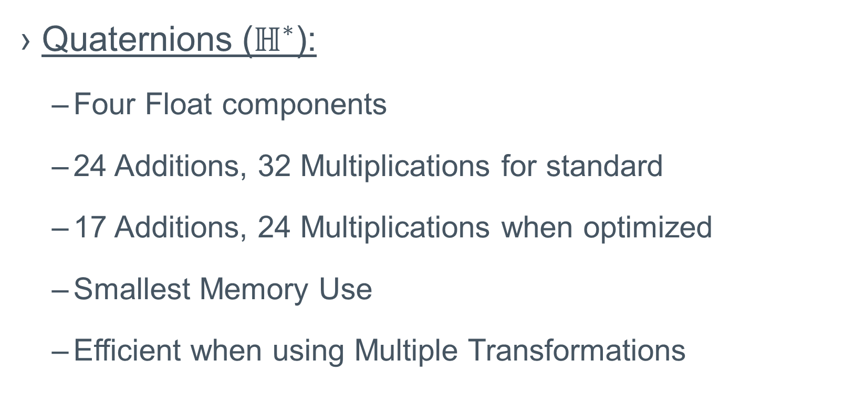
Which Representation to Use?
Quaternions ($ℍ^{∗}$):
Four Float components
24 Additions, 32 Multiplications for standard
17 Additions, 24 Multiplications when optimized
Smallest Memory Use
Efficient when using Multiple Transformations

Slide 14


Which Representation to Use? (Cont’d)
$$SO(3)$$
$$SU(2)$$
9 Float components
Initial creation requires a fair amount of computation
6 Additions and 9 Multiplications
Repeated use of a single transformation
Easy to Parallelize
4 complex Float components / 8 real Float components
Memory use depends on if language implements Complex Floats.
No easy way to compute, transform to Quaternion or SO(3)
Natural to use for Quantum Mechanics

Slide 15
Demo

Slide 16
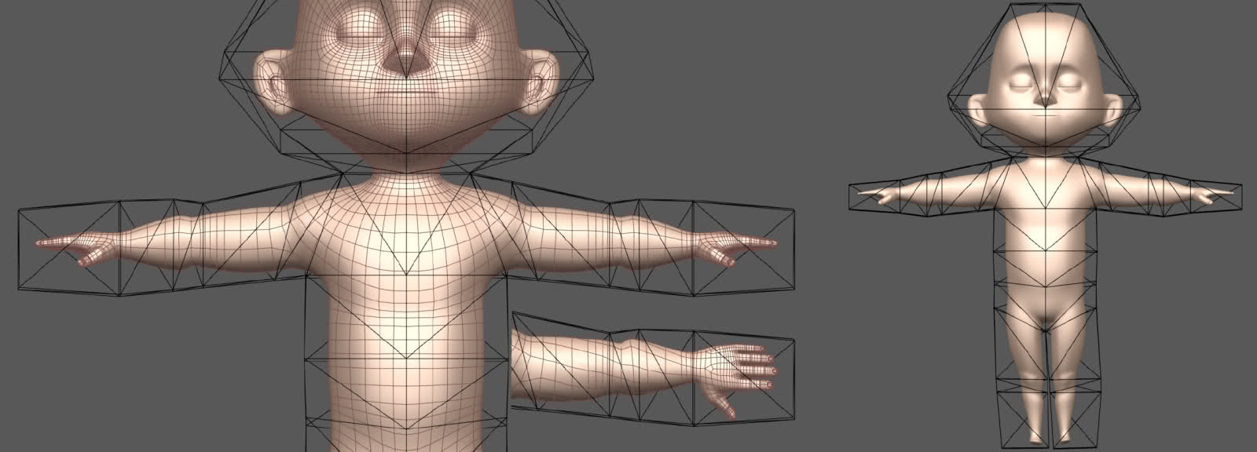
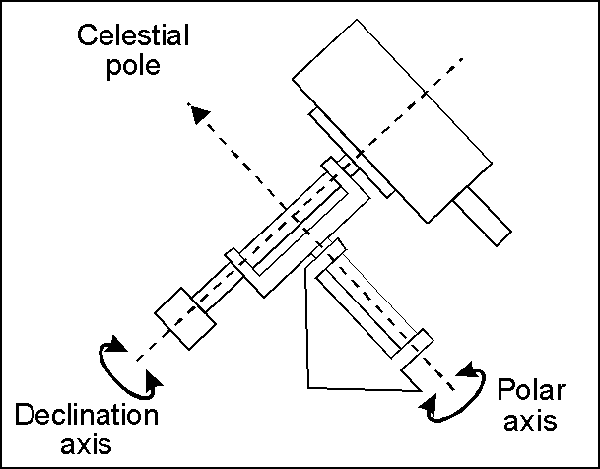
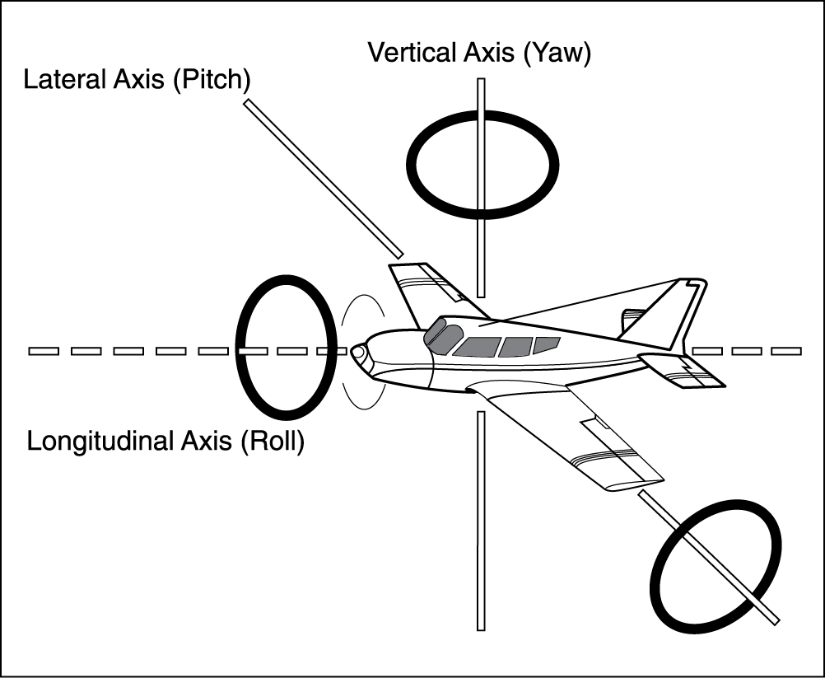
Applications
Computer Animation
Telescopy
Medical Imaging
Robotics
CAD Software
Statistics

Slide 17
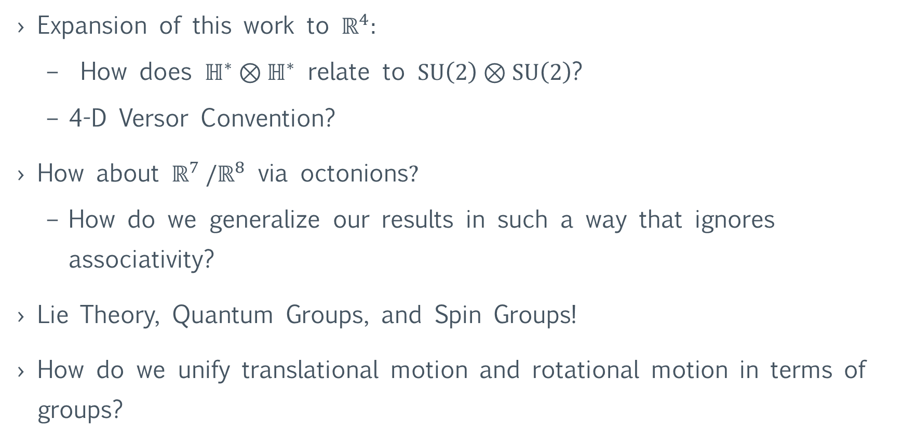
Further Studies:
Expansion of this work to $ℝ^{4}:$
How does $ℍ^{∗}⊗ℍ^{∗}$ relate to $\text{SU}\left(2\right)⊗\text{SU}\left(2\right)$?
4-D Versor Convention?
How about $ℝ^{7} /ℝ^{8} \text{via} \text{octonions}?$
How do we generalize our results in such a way that ignores associativity?
Lie Theory, Quantum Groups, and Spin Groups!
How do we unify translational motion and rotational motion in terms of groups?
Notes:
$\text{SU}\left(2\right)⊗\text{SU}\left(2\right)$ admits a 2:1 homomorphism onto$\text{SO}(4)$,

Slide 18
References:
Simon L. Altmann. Rotations, Quaternions, and Double Groups. Mineola, NY: Dover, 2005.
John H. Conwway and Derek A. Smith. On Quaternions and Octonions: Their Geometry, Arithmetic, and Symmetry. A K Peters, Ltd., 2003.
Jian S. Dia. “Euler-Rodrigues formula variations, quaternion conjugation and intrinsic connections”. Mechanism and Machine Theory 92 (2015), 144-152.
Govind S. Krishnaswami and Sonakshi Sachdev. “Algebra and Geometry of Hamilton’s quaternions”. Resonance – Journal of Science Education 21.6 (2016), pp. 529–433.
Cibelle Celestino Silva and Roberto de Andrade Martins. “Polar and axial vectors versus quaternions”. American Journal of Physics 70.9 (2002), pp. 958–963.
David Eberly. “Rotation Representations and Performance Issues”. Online. 2008.
Rhett Allain. “How Olympic Gymnasts Use Physics to Pull Off Those Crazy Twists”. Wired (August 2016). Online.

Slide 19
Thank You!

